Slide 1
THE SPARKS FOUNDATION
WEB DEVELOPMENT AND DESIGNING INTERN
Design By: Mohammad Kashif

Slide 2
TASK #1
Basic Banking System

Slide 3
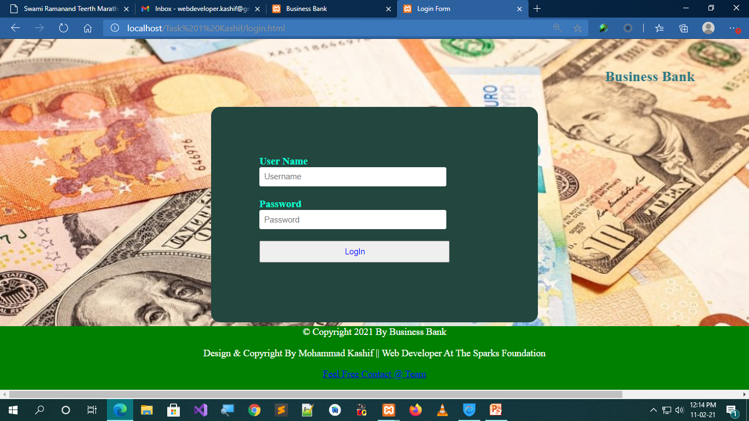

Slide 4
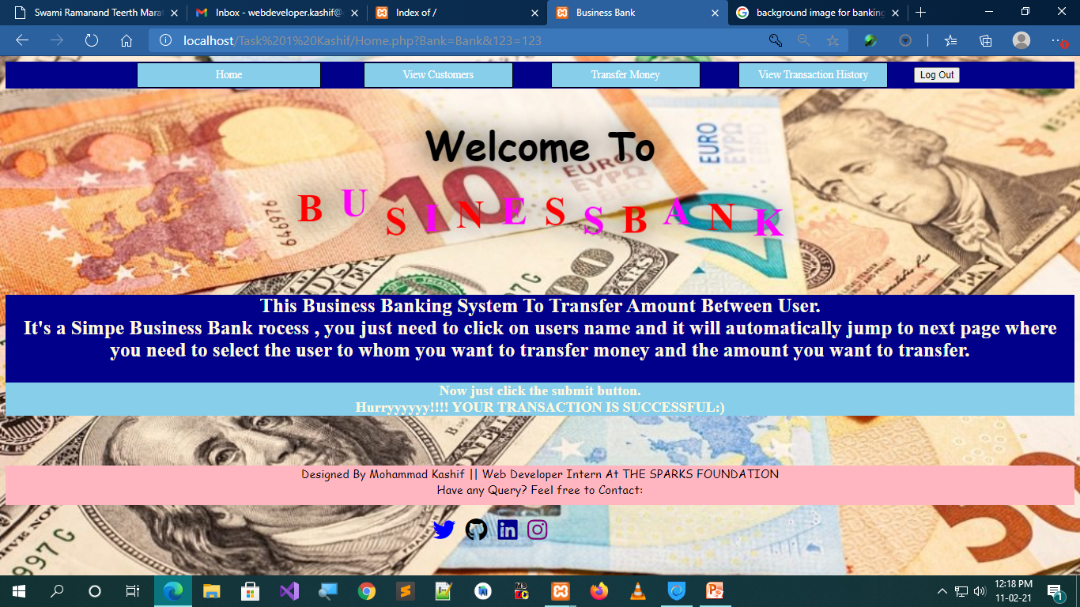

Slide 5
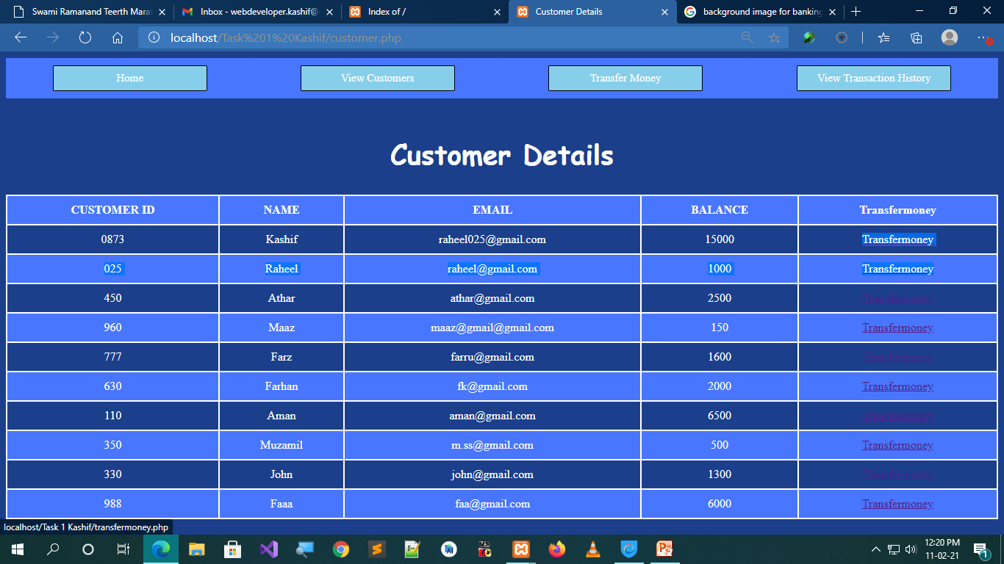

Slide 6
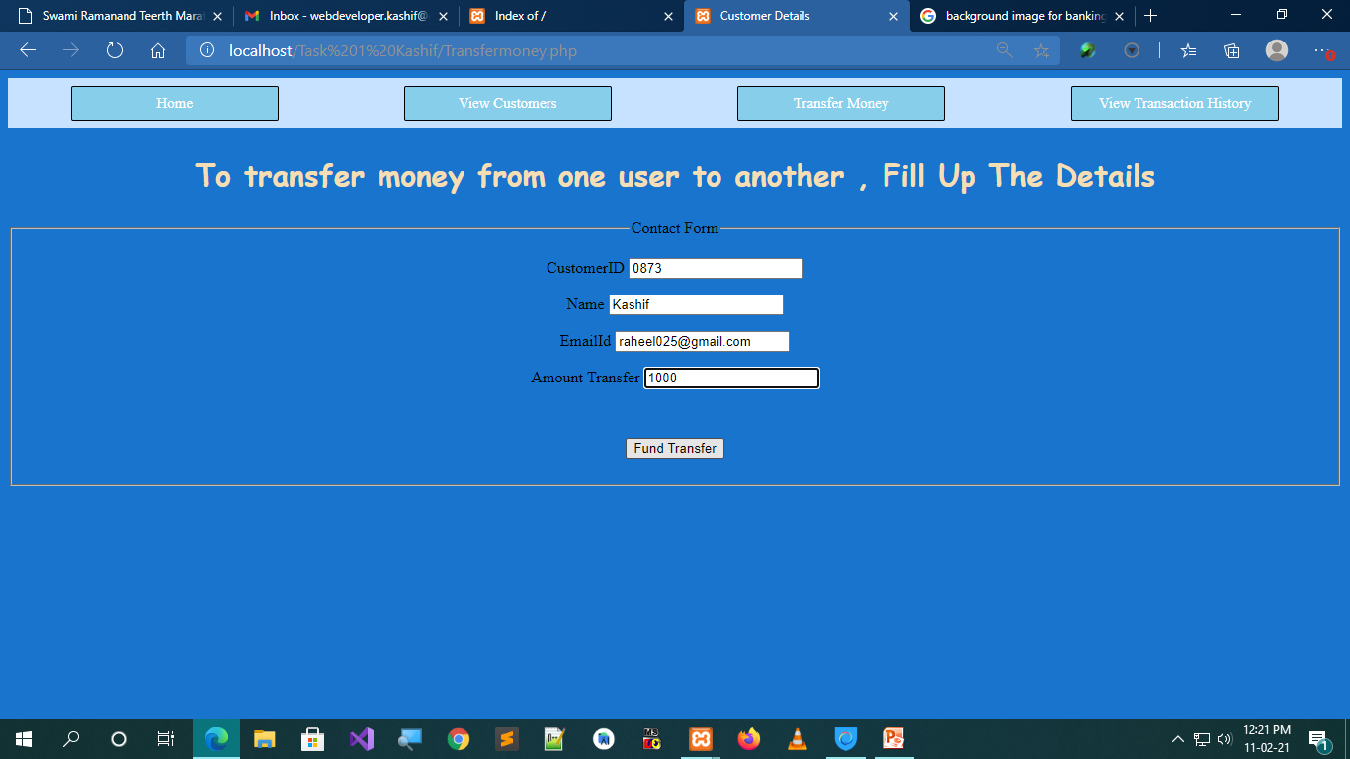

Slide 7
